Slide 1
Settling Into Primary One…
31st August 2023 | 9:10am – 11am
1st September 2023 | 9:10am – 11am
w/c: 4th September 2023 | 9:10am – 12noon
w/c: 11th September 2023 and thereafter | 9:10am – 2pm ***Stay and Play option: 2pm – 3pm***
***Supervision from 8:45am***

Slide 2
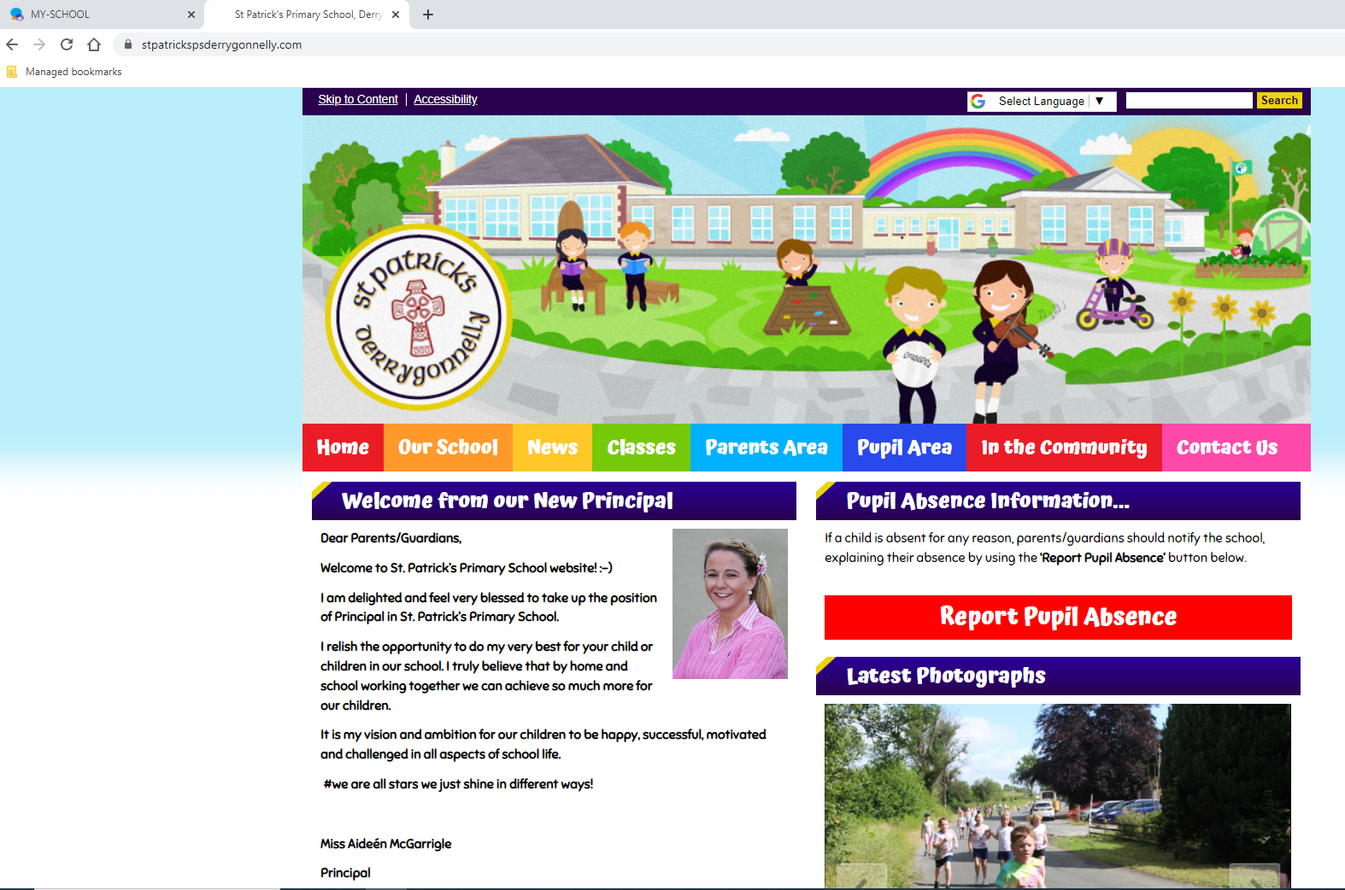
https://www.stpatrickspsderrygonnelly.com/
Phone numbers
Email addresses

Slide 3
Meet the P1 Team…
Notes:
We are very lucky to have:
*Mrs Jenny Scott and
*Mrs Collette Muldoon

Slide 5
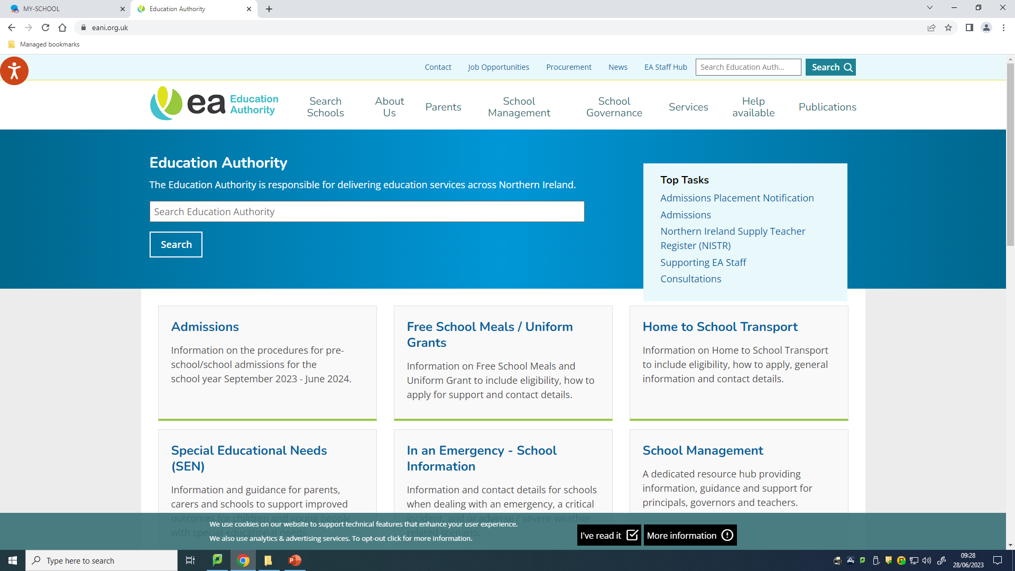
Transport / Meals…
www.eani.org.uk

Slide 6
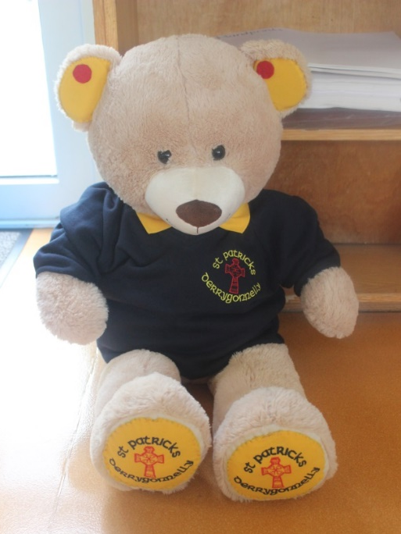
School Uniform…
School Days
Enniskillen
See handout
*PLAIN navy trousers/not leggings
NAMES
Please
on ALL clothing

Slide 7
Any questions?

